Slide 1
Applied Data Science Capstone
Capstone Project - The Battle of Neighborhoods (Week 2)

Slide 2
Introduction: Business Problem
Clearly define a problem or an idea of your choice, where you would need to leverage the Foursquare location data to solve or execute. Remember that data science problems always target an audience and are meant to help a group of stakeholders solve a problem, so make sure that you explicitly describe your audience and why they would care about your problem.
The purpose of this project is to help people planning to open a new restaurant in Toronto to chose the right location by providing data about the income and population of each neighborhood as well as the competitors already present on the same regions.
Lots of people are migrating to various states of Canada and needed lots of research for good opening a Business like a restaurant. This project is for those people who are looking for better neighborhoods. For ease of accessing to a restaurant.
This project aims to create an analysis of features for people migrating to Scarborough to search the best neighborhood as a comparative analysis between neighborhoods.
It will help people who have businesses to get awareness of the area and neighborhood before moving to a new city, state, country, or place for their work and business.
So the Problem Which Tried to Solve:
The major purpose of this project is to suggest a better neighborhood in a new city for the person who is shifting there to open a new business. Sorted list of restaurants in terms of restaurant prices in an ascending or descending order.

Slide 3
Data
Data Link: https://en.wikipedia.org/wiki/List_of_postal_codes_of_Canada:_M
for population: https://en.wikipedia.org/wiki/Demographics_of_Toronto_neighbourhoods
Will use Scarborough dataset which we scrapped from wikipedia on Week 3. Dataset consisting of latitude and longitude, zip codes.
The data retrieved from Foursquare contained information of venues within a specified distance of the longitude and latitude of the postcodes. The information obtained per venue as follows:
1. Neighborhood
2. Neighborhood Latitude
3. Neighborhood Longitude
4. Venue
5. Name of the venue e.g. the name of a restaurant
6. Venue Latitude
7. Venue Longitude
8. Venue Category

Slide 4
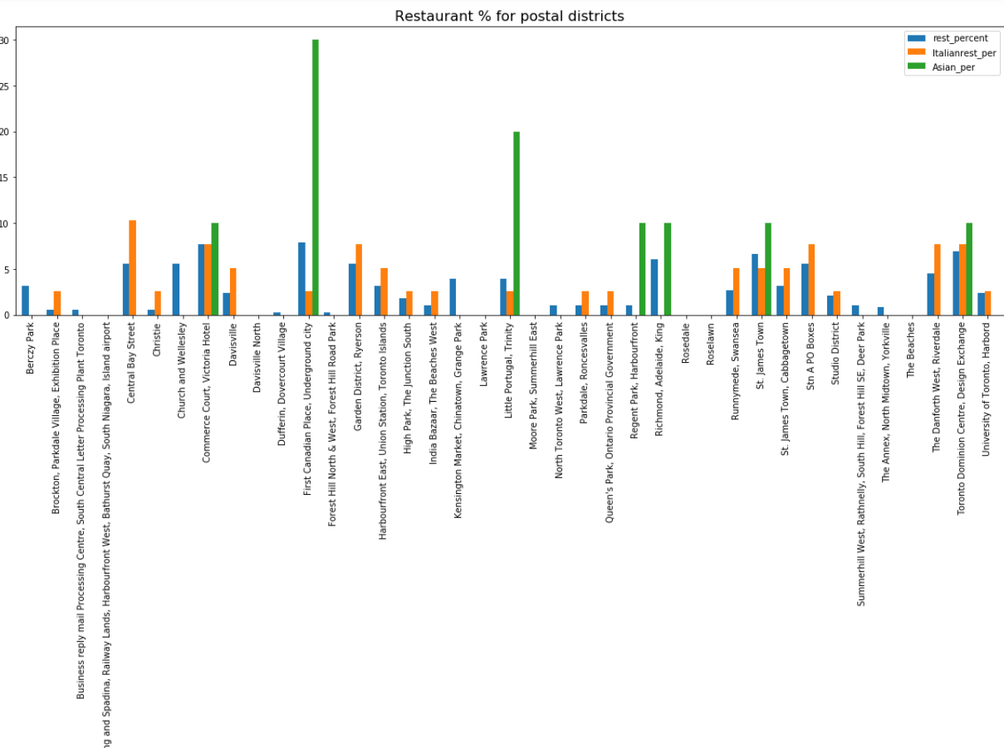
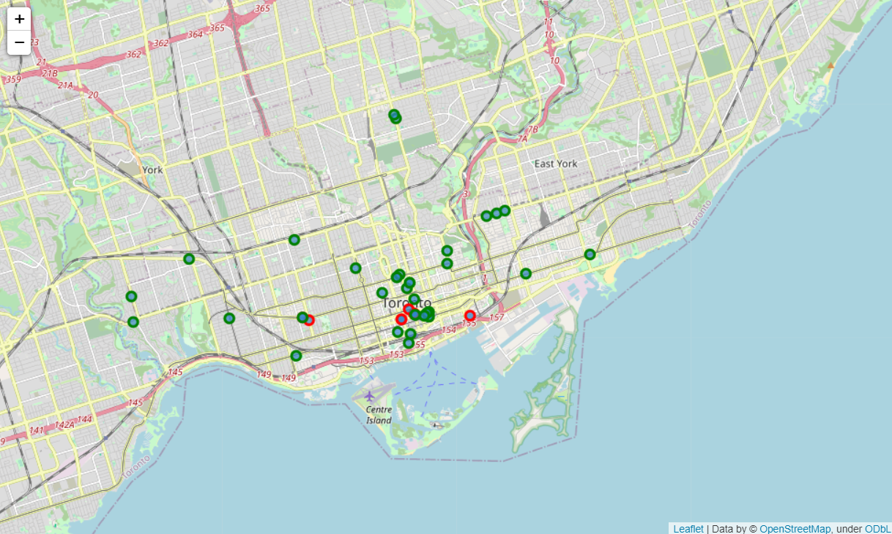

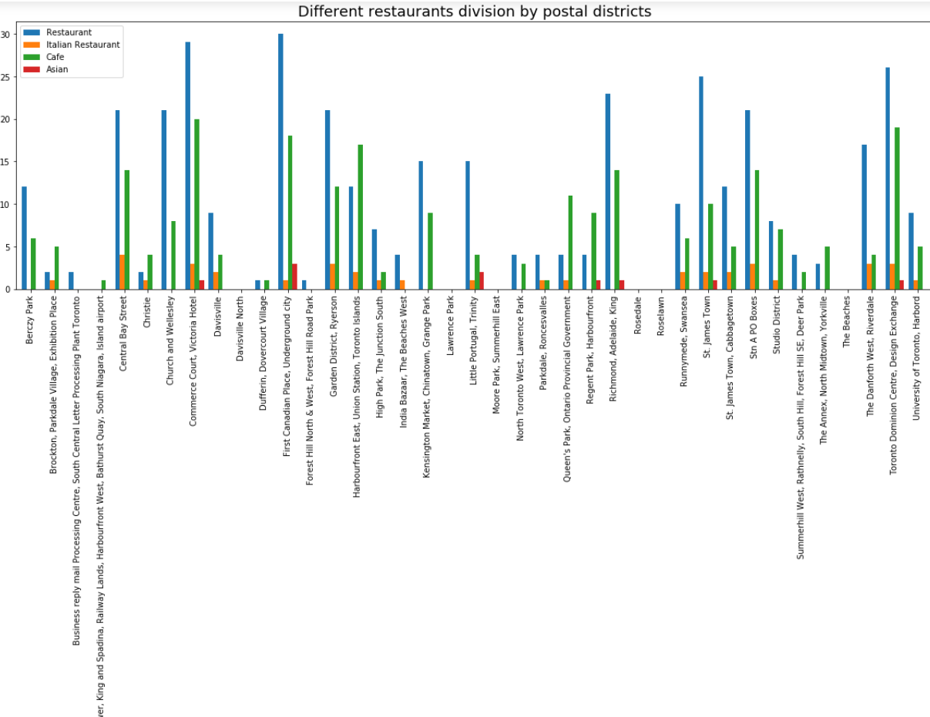
Results & Analysis
Fingal,Dublin4,8
Planning a restaurants business in Toronto?
Which area will be less competitive yet have good potential?

Slide 5
Results & Analysis

Slide 6
Results & Analysis

Slide 7
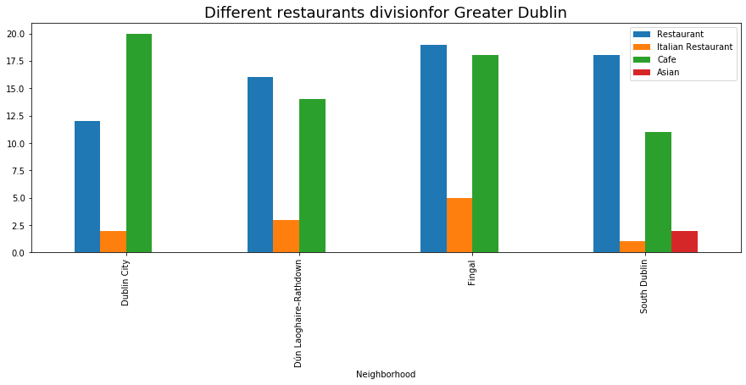
Results & Analysis

Slide 8
Results & Analysis

Slide 9
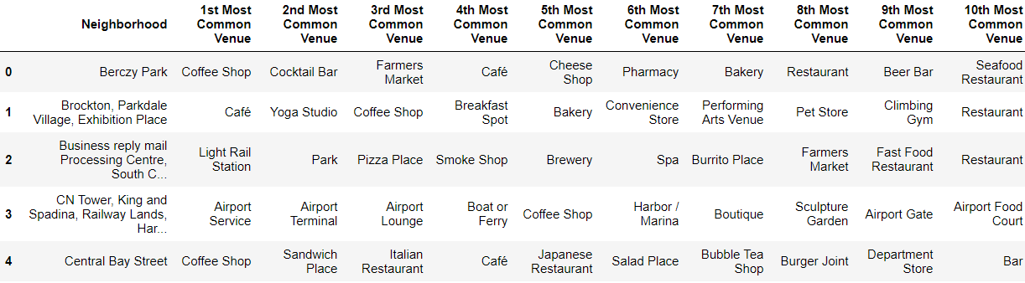
Results & Analysis

Slide 10
Analysis
Overall Asian Restaurants have less existence in Toronto City. first canadian place, Underground city and Commerce court, Victoial hotel areas, region which has plenty of restaurants and cafe otherwise.
Assuming Asian migrated peoples are settling in first canadian place, Underground city and Little portugal, Trinity postal districts majorly, hence Little portugal, Trinity can be a good potential area for Asian restaurant.

Slide 11
Conclusion
Little portugal, Trinity, Richmond, Adelaide, king and Regent park would be potential regions to open a Asian Restaurant.
Assuming increasing population in Richmond, Adelaide, king and Regent park region, Asian restaurants would have good potential in these areas of Toronto.

